Slide 1


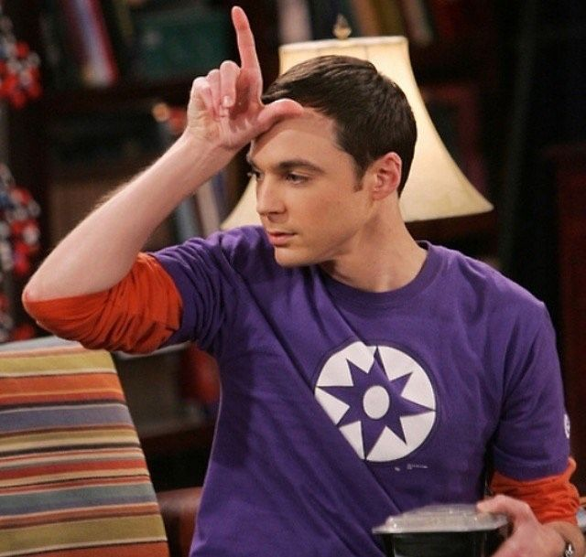
Enhance your gaming performances by being a nerd
Mathieu Jomain
JUL, 8th | PARIS
DAFT MAY2022

Slide 2


Business case
Domain
The growth of the e-sports market is significant and their demand for game and meta data analysis is growing accordingly.
Many factors have to be considered to perform in video games other than the athlete's abilities.
Problem
The goal of this project is to forecast the performances of a ‘League of Legend’ champion based on its performances on the previous patch.
It will allow to have game insights, a resource used by e-sport teams.
Notes:
Explain RiotGame and LoL (created 2009) - 125 million monthly LoL players - around 3.5 million daily players (peaked at 11million)
Average of 700,000 League of Legends players that play the game simultaneously
Rise of esport: wolrd cup each year around oct/nov and regional cup the rest of the year
Explain what is patch

Slide 3

Business case

Slide 4
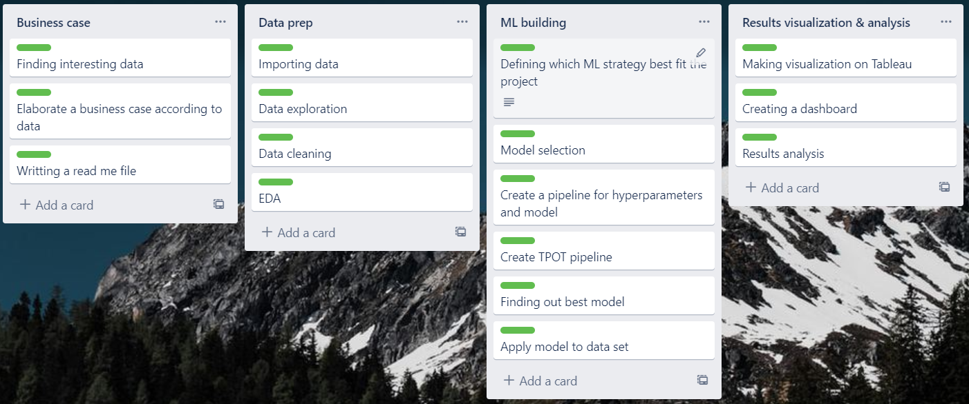
Plan
Data exploration & cleaning
EDA
Defining models hyperparameters
Machine Learning models building
Models evaluation & comparison
Results visualization & analysis

Slide 5
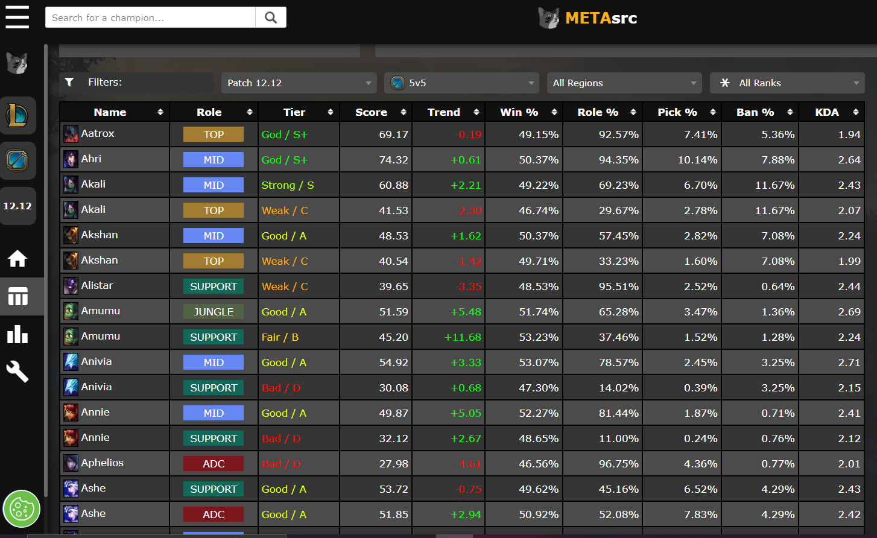
About data
Metadata
Dataset available on Kaggle
Original source: metasrc
Data that contains several indicators about League of Legends Champions
Each csv file corresponds to a different patch
Shape (241 x 11)
Name : Name of the champion
Class : Fighter, Assassin, Mage, Marksman, Support or Tank
Role : Top, Mid, ADC, Support or Jungle
Tier : God, S, A, B, C or D
Score : Overall score of the champion
Trend : Trend of the score
Win % : Win rate of the champion
Role % : Role rate played with the champion
Pick % : Pick rate of the champion
Ban % : Ban rate of the champion
KDA : (Kill+Death)/Assist ratio of the champion
Notes:
Metasrc might have get the data using RiotGame API website

Slide 6
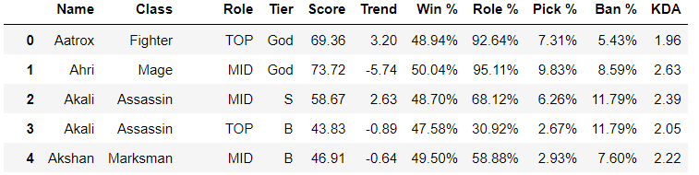
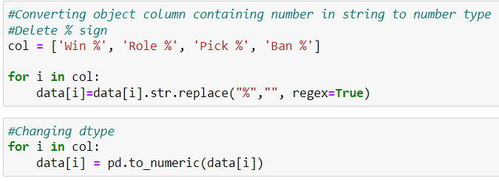
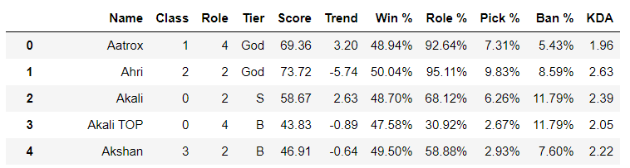
Data cleaning, data prep
Encoding
Conversion of object data to numeric
Notes:
General cleaning process: missing values, duplicate row, value counts…
Create dictionnary to keep before and after encoding value in case I need it later on

Slide 7
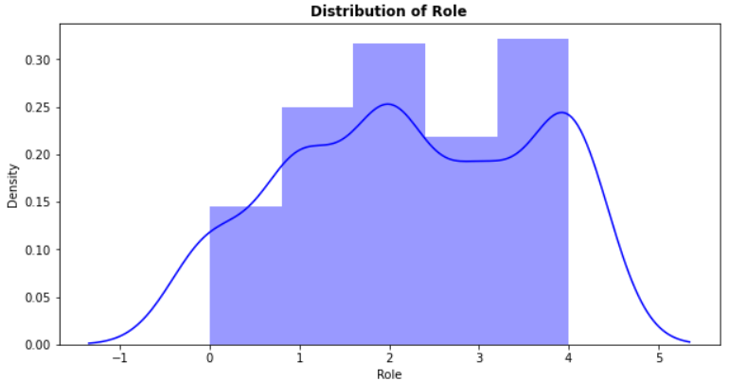
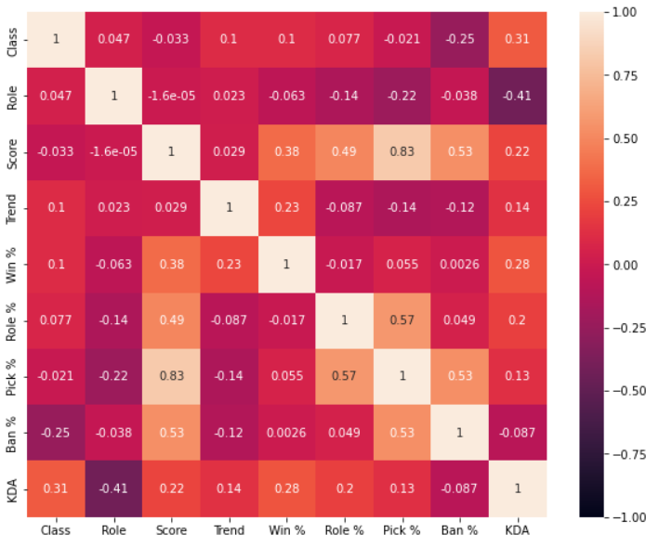
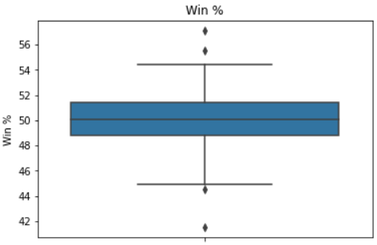
EDA
Histogram
Correlation matrix
Boxplot
Notes:
Corr matrix: high corr col?
Boxplot: info -> distribution (outlier / median / range)
Hist: distribution of Class / Role -> ADC:0, JUNGLE:1, MID:2, SUPPORT:3, TOP:4

Slide 8
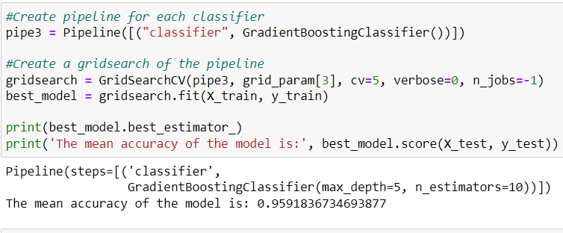
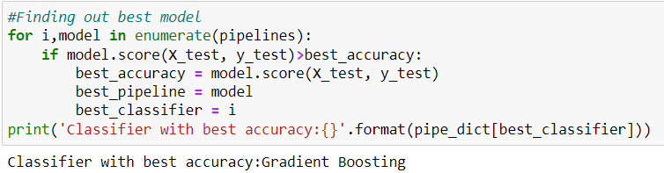
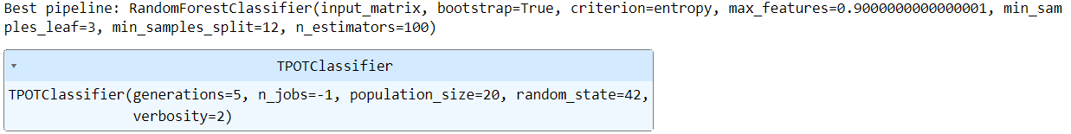
Models
Hyperparameters tuning
Supervised Machine Learning: y = Tier
Pipeline for hyperparameters tuning
Pipeline for model selection
TPOT pipeline for model selection number 2
Best model selection using pipeline
Best model selection and hyperparameters using TPOT

Slide 9
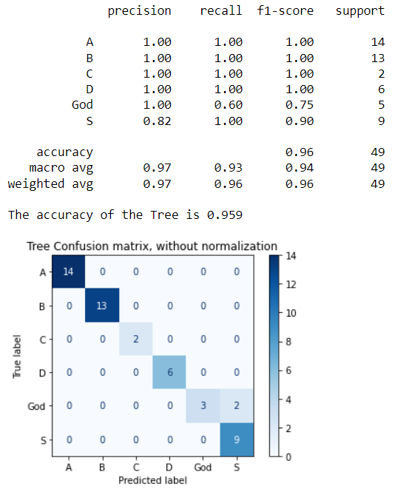
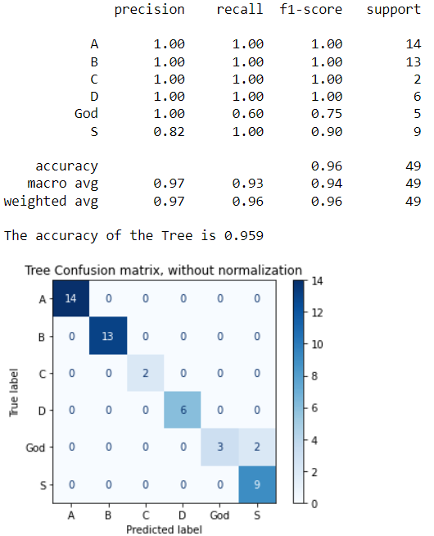
Models evaluation
My pipeline: Gradient Boosting
TPOT pipeline: Random Forest
Notes:
Here we get exact same results from GradientBoosting and RandomForest because these 2 are really similar: Decision trees classifier
random forests (trees are independent), gradient boosting trees are built one after another (additively).
Each new tree is built to improve on the deficiencies of the previous trees and this concept is called boosting.
God predicted as S (underpredicted)
Speak about number and meaning (prec – recall … =1 means prediction is accurate)

Slide 10
Conclusion
The performance of Gradient Boosting Classifier and Random Forest Classifier shows 96% of accuracy.
Those results give insights about the game. Knowing how a champion will perform is a valuable insight for most of e-sport teams. Thus, the ML provides the approach of champions classification.
But we have to keep in mind that the game environment is changing fast (patch happens every 1 or 2 weeks) depending on the balancing of the game. That brings the last aspects that limits this kind of predictive model. In-game changes that are made by the balance team cannot be taken into accounts before the release.
Notes:
Valuable ressource that esport team are craving for
Example of changes: damage increase / decrease, change of cooldown duration of spells, base statistics such as health points…

Slide 11

Enhance your gaming performances by being a nerd
Questions?
Mathieu Jomain

